Slide 1
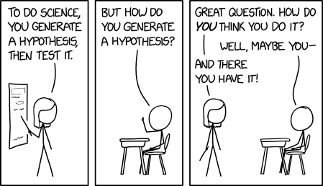
Exploring datasets
Generating hypotheses

Slide 2

What does each parameter mean – should be in metadata, or google or ASK
Make your own notes
Why was it made?
What are you looking for?

Slide 3
What is a good hypothesis?
Asking the same question with a different parameter?
A question you’ve seen asked in a review paper?
An idea which came to you in a dream?
Something your funder would like to see?

Slide 4
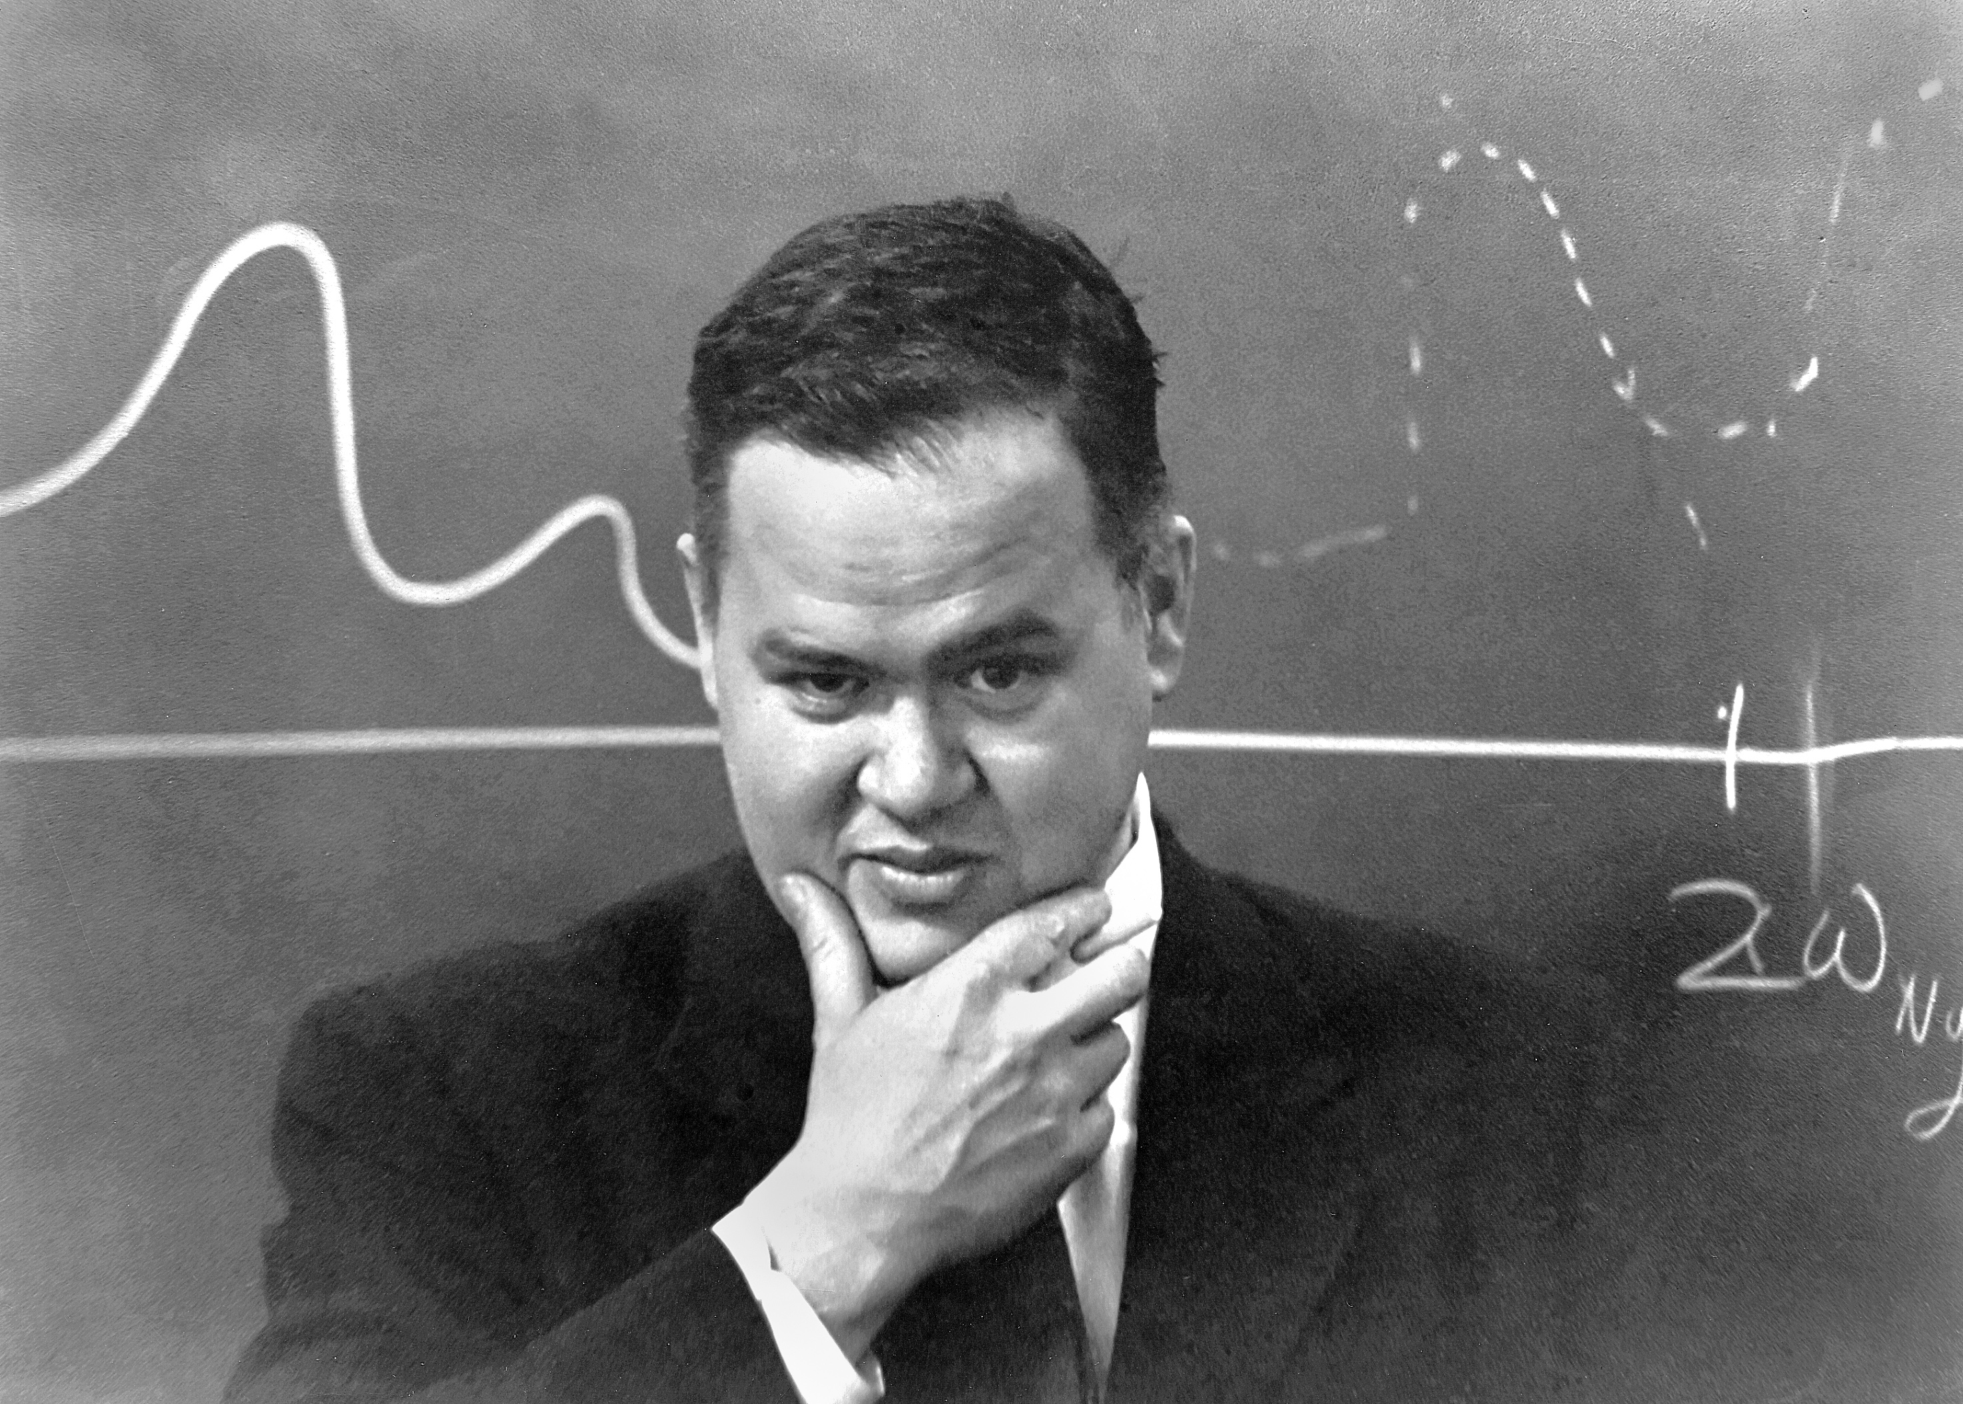
“The data may not contain the answer. A combination of some data and an aching desire for an answer does not ensure that a reasonable answer can be extracted from a given body of data” John Tukey
Hypothesis for a data analysis:
An answerable question about a pattern in the data

Slide 5
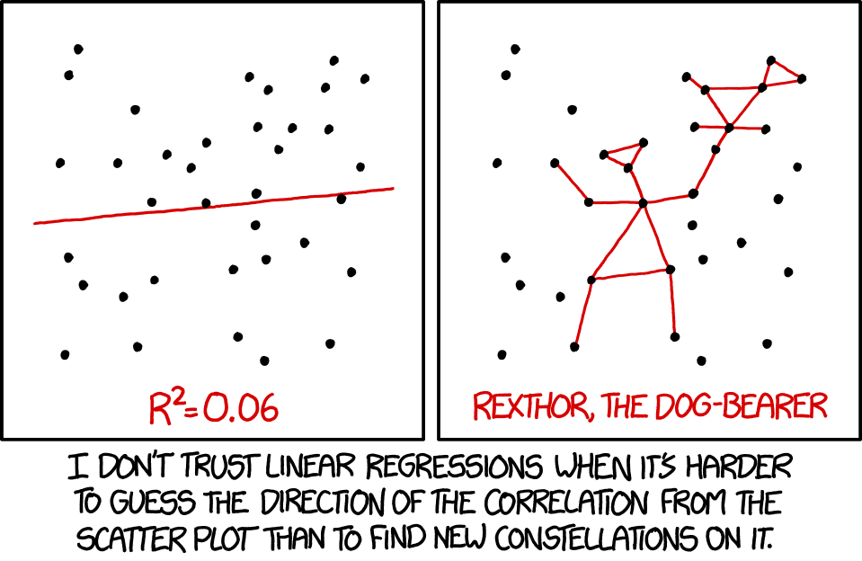
How to go from seeing a pattern to explaining it?
Can you model the relationship?
y = bx + c
Bedsheet deaths = b* cheese consumption + c
Tendency to complicate model by adding in more factors and parameters until it fits.

Slide 6
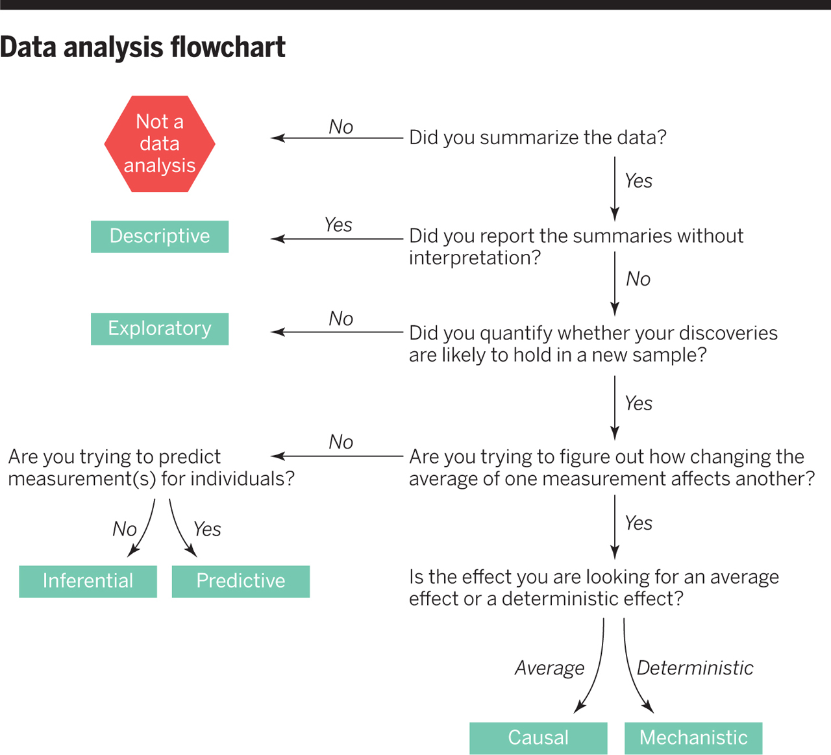
Asking the right question
Exploratory – What is the pattern?
Inferential – What is correlated with the pattern?
Is it seen in all datasets?
Predictive – Can one measure predict the other?
Test with a second dataset
Causal – What causes the relationship?
Manipulate system to test
Mechanistic – How is the relationship produced?
Show deterministic link
Leek et al., (2015) What is the question? Science 347:1314-1315 DOI: 10.1126/science.aaa6146

Slide 7
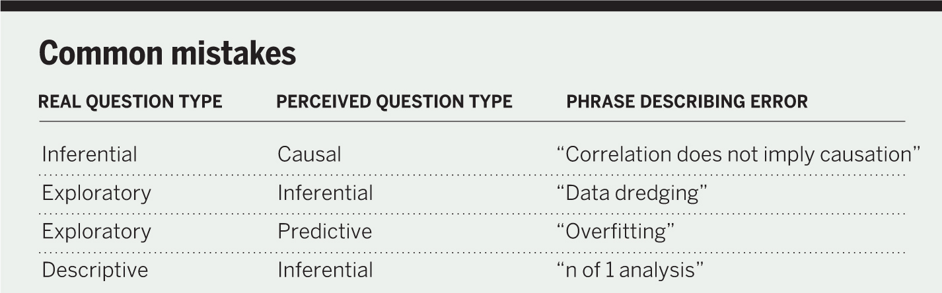
An analysis can be fully reproducible and still be wrong.

Slide 8
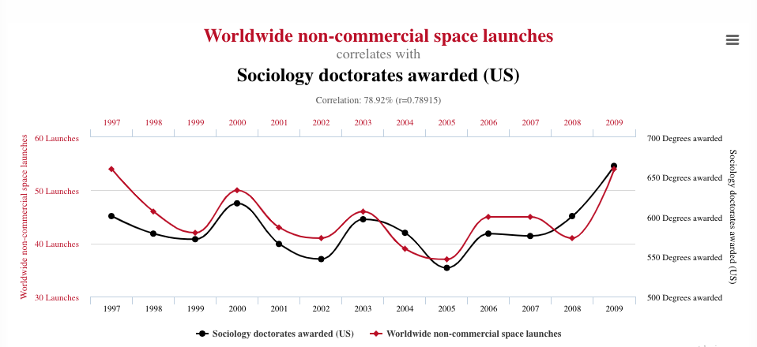
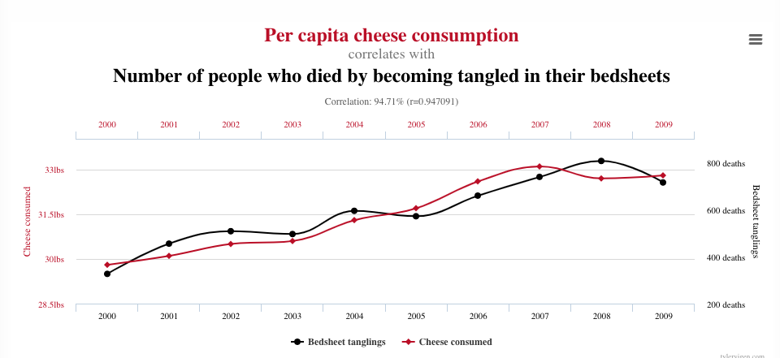
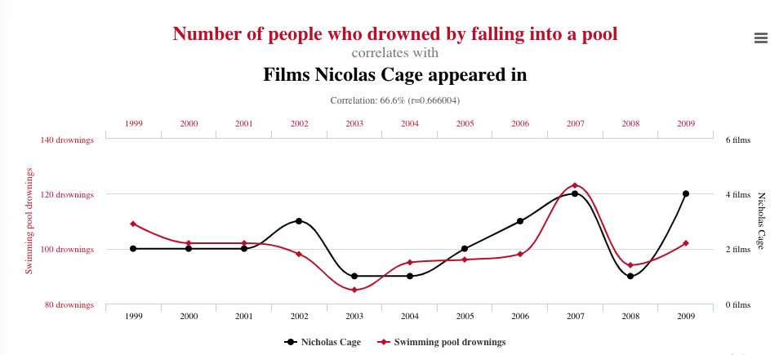
Correlation without causation
Can you model the relationship?
y = bx + c
Bedsheet deaths = b* cheese consumption + c
https://www.tylervigen.com/spurious-correlations

Slide 9
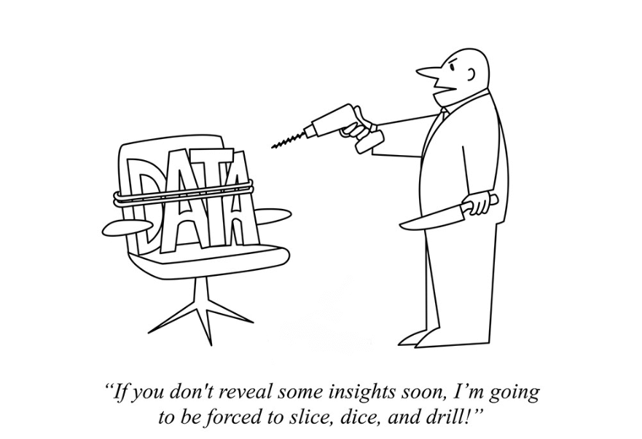
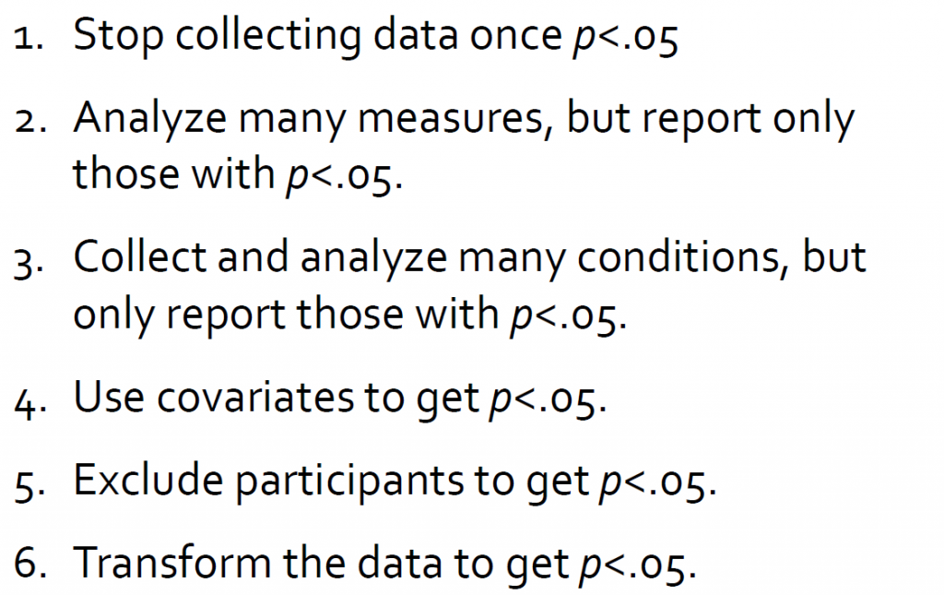
Data Dredging
If you torture the data enough, nature will always confess”
Ronald Coase

Slide 10
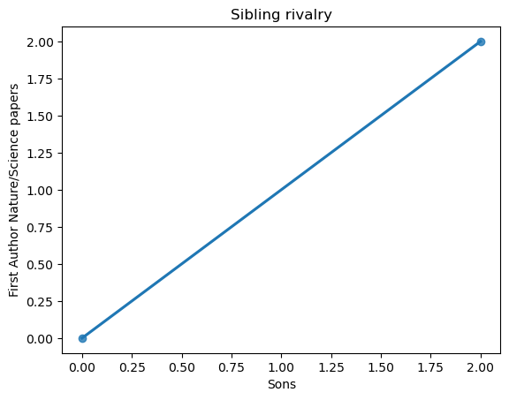
N= 1 analysis
The smaller the data set the easier it it to get a strong correlation and a simple model fit

Slide 11

Overfitting
Tendency to complicate model by adding in more factors and parameters until it fits.
If you try enough models on one set of data you will eventually find one that fits perfectly.
However, it is unlikely to fit a second dataset and is likely to be mostly telling you about the pattern of noise in the first dataset.

Slide 12
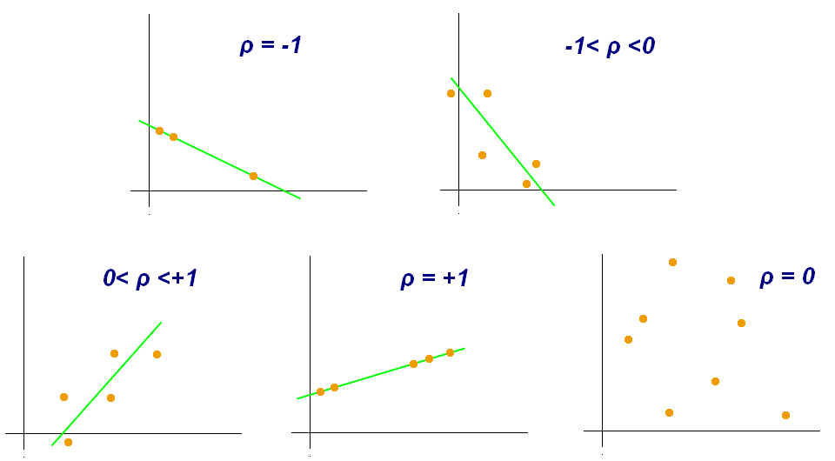
Pearson

Slide 13
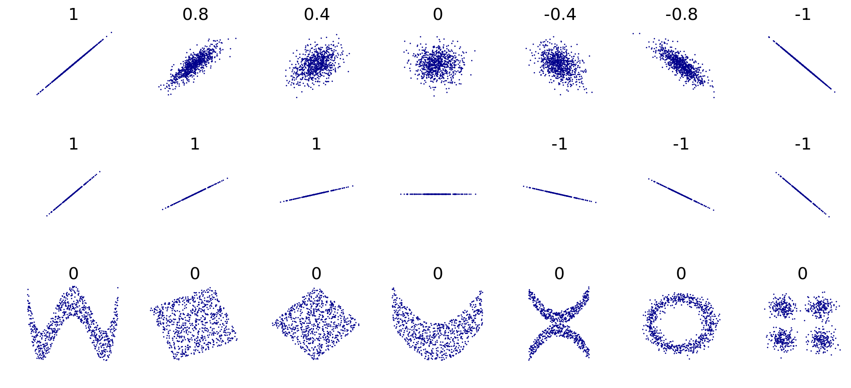
Non-linear correlations can be difficult to detect with standard measures
Pearson’s correlation coefficient of x and y for each dataset

Slide 14
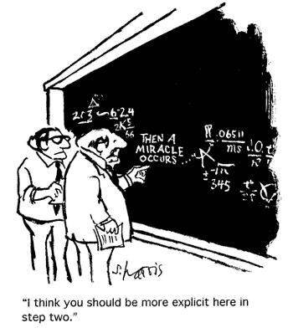
Raw data
Tidy data
Where is it from?
How was it collected?
What format was it in?
Ready to test your explicit hypothesis
Notebook of process
Information on each variable (full name, units)
Experimental aims and plan
The code and the REASON FOR IT!
Parameters, software versions, sources
REPEATABLE

Slide 15


Have you coded variables correctly?
Continuous
Ordinal
Categorical
Missing
TIDY DATA
Continuous – as float
Ordinal – as integers
Categorical – as useful descriptors
(not number grades, but “good’, “fair’ “poor’
Missing – Not 0 or any other number.
Worth having a column for ‘questionable data’

Slide 16
Use df.info() to check your data have the types you’re expecting
Change if needed:
df = df.astype({"Field": string})
Check the values in a categorical field
df.category.unique()
And distribution of values in a numeric field
sns.histplot(data=df, x=”Measurements")
Check if columns that should be the same are the same
(important when you have combined data)
df['new_column'] = df['column_one'].equals(df['column_two’])
PLOT
Pairplot will reveal outliers and oddities, but try several methods
sns.pairplot(data=df)
TIDY DATA
TIDY DATA

Slide 17
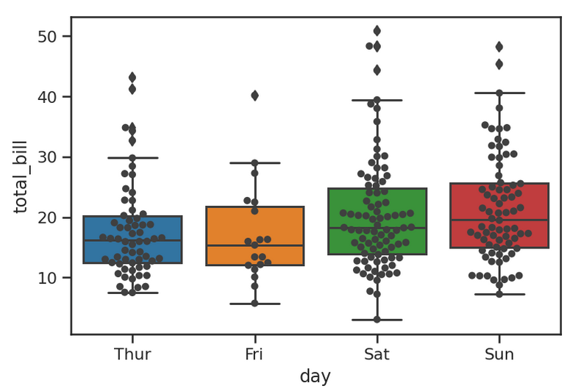
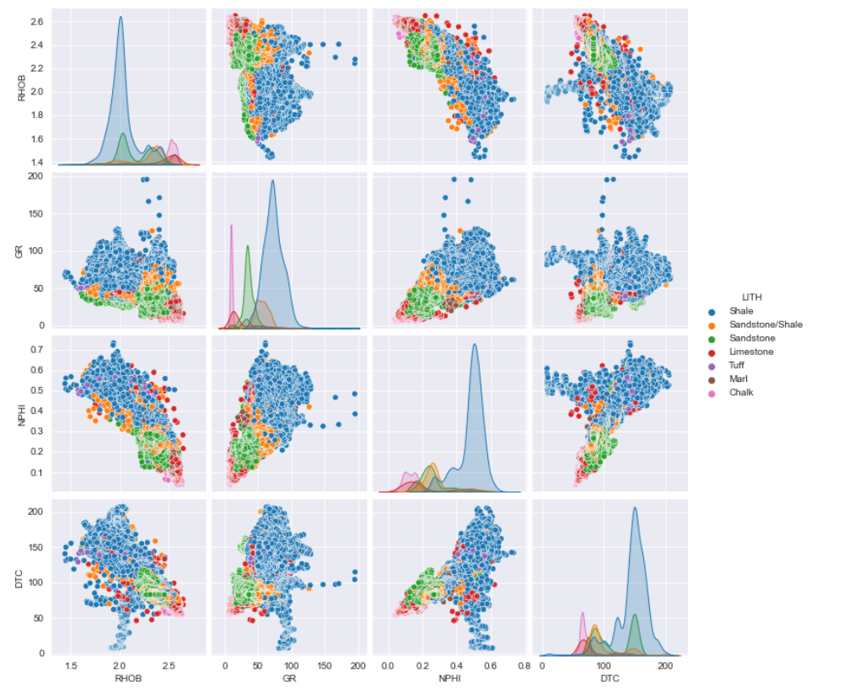

Exploring your tidy data
First look
Show as much of the raw data as you can.
Swarmplots on top of boxplots,
Scatterplots
Everything against everything (pairplots)
Use subsamples to confirm the robustness of the pattern
As many quick plots as you can, and different methods

Slide 18
Exploring your tidy data
Explaining odd patterns
Use colour to examine confounding relationships
Try logs of variables
Remembering to do logx +c, or treat 0 a special cases)
Bland-Altman/Tikkey mean -difference plots
x+y versus x-y, highlights differences
Check effects of missing values – are they a random set?

Slide 19
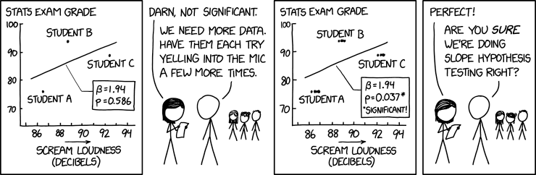
Caution
Is your sample representative of the population?
Think about possible confounders
Can you code these in and check?
Check for dependencies on time and geography
Very small and very large datasets can be problematic
Small – not enough data to be certain of effects
Large – lots of noise, lots of confounding effects
What is your real sample size?
How many independent measures do you have?

Slide 20
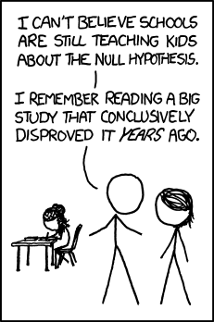
Hypothesis: A clear explanation of causes of the pattern
Experiment: How you will test the hypothesis by using data to prove or disprove it
Hypothesis: Cheese consumption causes death by bed sheet entanglement
Null Hypothesis: Cheese consumption has no effect on death by bed sheet entanglement
Lab Experiment: Controlled cheese eating and monitoring death rates
Data Experiment: Does the same relationship hold worldwide?
Have bed sheet death rates increased with the increase in cheese consumption in China?
Data Experiment: Does the same relationship hold for all cheeses?
Break down data by cheese variety
Data Experiment: Does the relationship hold for day and night deaths?
Break down data by time

Slide 21
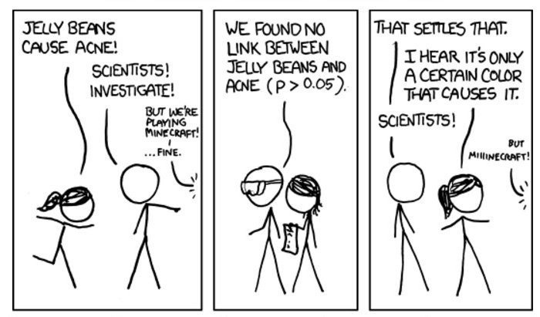
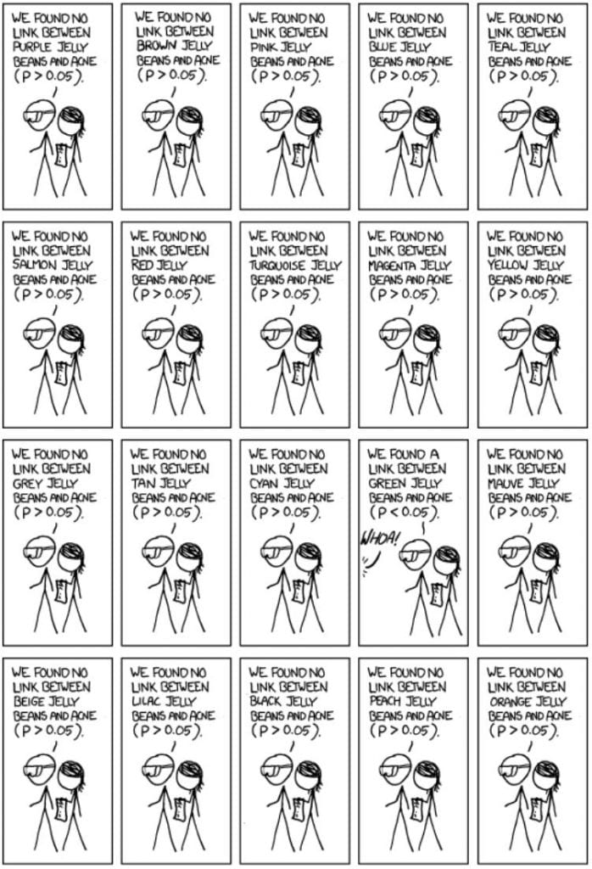
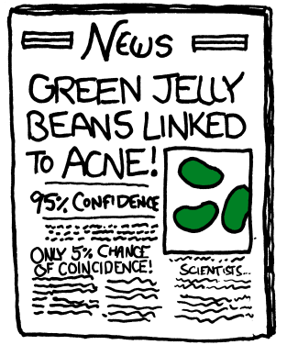
Multiple testing
If you are using a 5% significance level and do 20 tests it’s likely one will be false positive
Use a Bonferroni correction for this (though it tends to be on the conservative side)

Slide 22
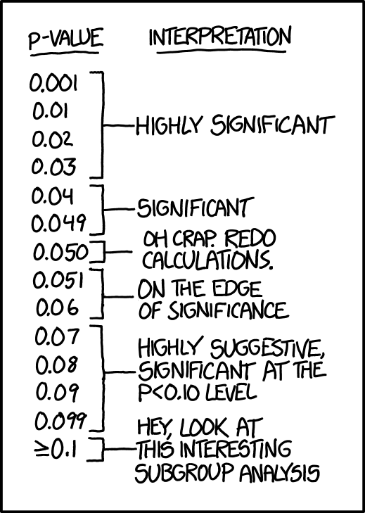
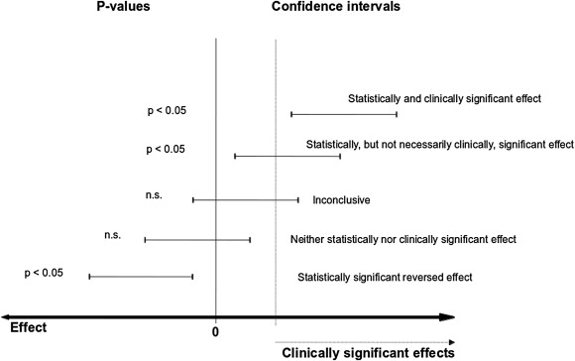
P values alone are not the solution
P values are not a measure of effect size.
P value is SIGNIFICANCE, Confidence interval is SIZE. Both are important
Probability of the observed or more extreme results under null hypothesis

Slide 23
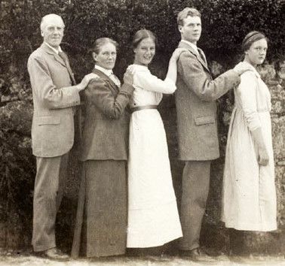
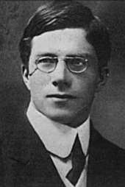
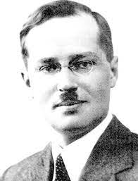

P Values
Devised by Fisher in the 1920s,
Could random chance explain your data pattern?
Set up a null hypothesis
Determine the likelihood of your data under the null hypothesis
p-value = probability of the observed or more extreme results
More than one approach to statistical testing
“worse than useless”
“childish”
Power calculations
Devised by Neyman and Pearson during a week in Paris in 1927
Tests competing hypothesis
Attentive to type1 and type 2 errors
Attentive to power of tests to detect signal
*
Egon Pearson (son of Karl)
Bayesian approaches
Devised by Thomas Bayes in Tunbridge Wells in 1750’s
Includes Prior Probablity (pre-data knowledge) and likelihood (evidence from data ) to produce a Posterior Probability
Thomas Bayes
Ronald Fisher
Jerzy Neyman

Slide 24
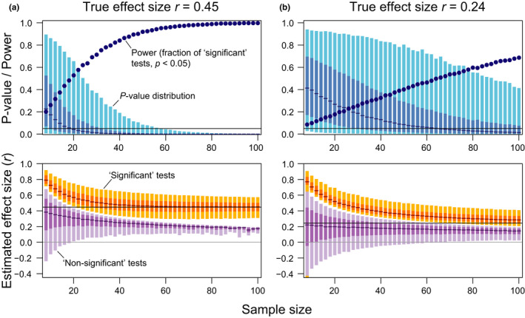
P values and effect sizes are produced from a sample so will vary
Good descriptive statistics
Good exploratory statistics
Estimate size of effect
Estimate reliability
(Confidence intervals)
The ‘Null hypothesis’ may be meaningless
Absence of statistically significant evidence is not evidence of absence
Comparing two biological valid hypothesis will often be more meaningful than testing for ‘some pattern’ over ‘ no pattern’
Small effects can be masked by low analysis power
Berner D, Amrhein V. Why and how we should join the shift from significance testing to estimation.
J Evol Biol. 2022 Jun;35(6):777-787. doi: 10.1111/jeb.14009.

Slide 25
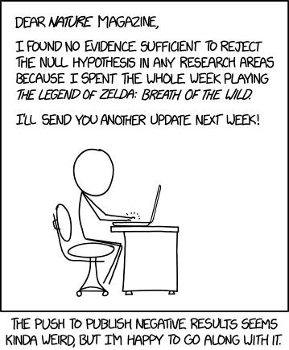
Writing it up
What question are you answering?
Experimental Design
Details of data set
Outline analytical approach
Outline likely sources of error
Always include variation /confidence limits on estimates
Discuss outliers/oddities
Include only the useful explorations – not all the dead ends!
Reference the approaches you use

Slide 26
